Slide 1
Servlets
Waqar Yar

Slide 2
Servlet Lifecycle
Being initialized (running the int() method)
Initialized (running the service() method)
Destroyed (running the destroy() method)

Slide 3
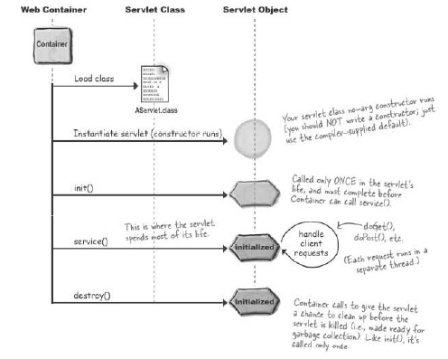

Slide 4
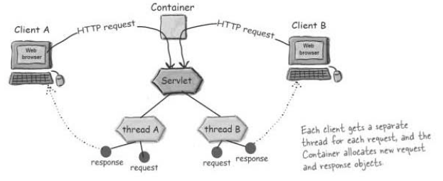
Servlet Threads

Slide 5
Loading and Initializing
Finding the class- This happens when the Container is started.
Loading the class- This happens is Container Startup or first client use.
The servlet moves from non-existant state to initialized using a constructor.
The Object becomes a servlet when it gets the ServeltContext.

Slide 6
ServletConfig
One Servlet object per Servlet
Used to pass deploy time information.
Used to access ServletContext.
Parameters are configured in the Deployment Descriptor.

Slide 7
ServletContext
One ServletContext per Web Application
Used to access Web Application Parameters. (These are in Deployment Descriptor)
This is the place attributes can be added where other parts of the application can access it.
Used to get Server information.

Slide 8
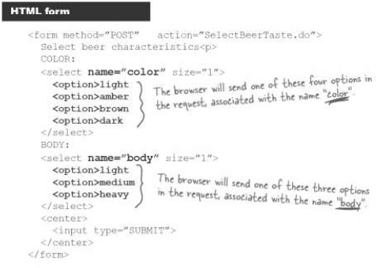
Sending Parameters-Request Object

Slide 9
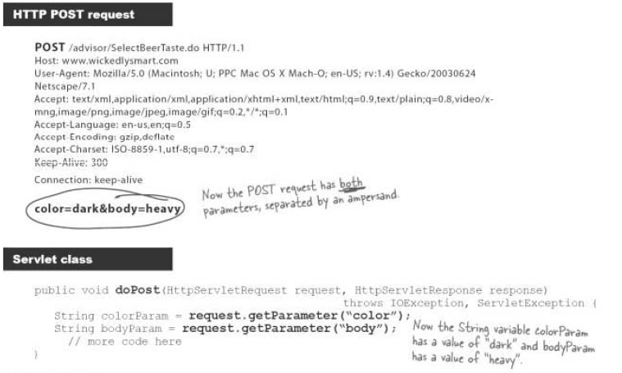

Slide 10
Response Object
Use the response to send data back to the client.
The following methods are commonly used:
setContentType() – This is to set content type
getWriter() – This is to write characters to the response.
Response headers can be set by:
setHeader()
addHeader()

Slide 11
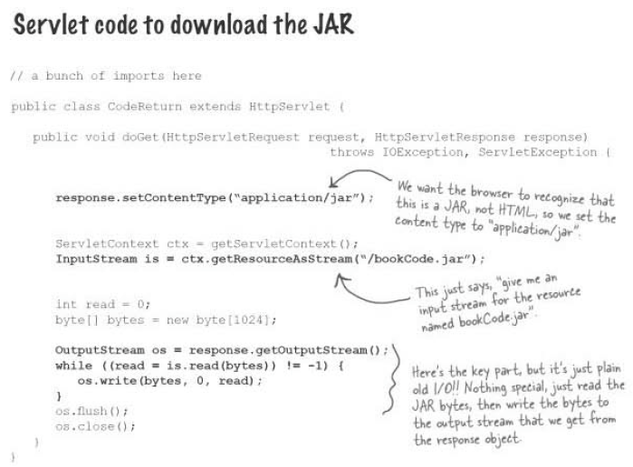

Slide 12
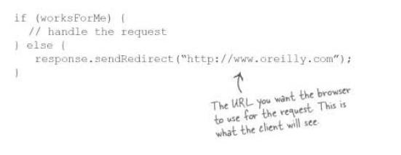
Redirecting

Slide 13
Redirect vs Request Dispatch
In redirect goes to a new URL
The user sees the new URL in the browser.
In Request Dispatch the request is passed internally to a new program.
The users do not see a change of URL in the browser.

